Slide 1
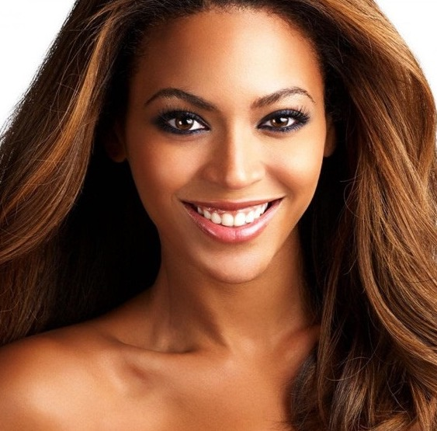
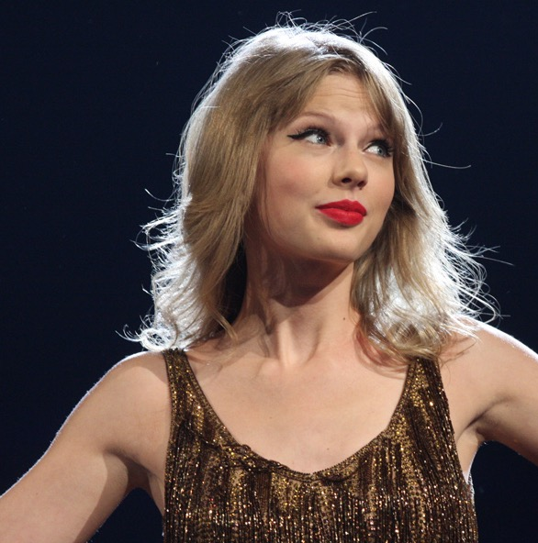
Beyoncé brushes her hair before going to school.
Taylor Swift always tries her best.
Ed Sheeran helps lay the table.

