Slide 1
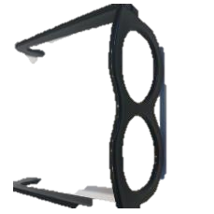
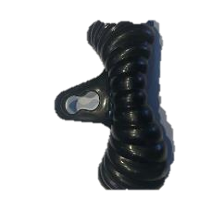
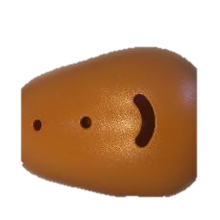
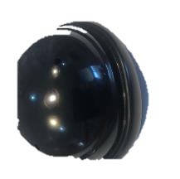
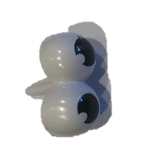
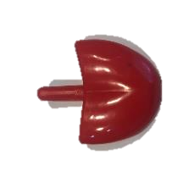
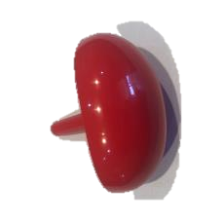
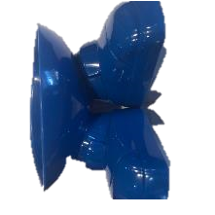
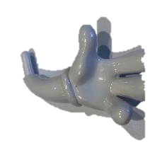
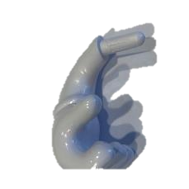
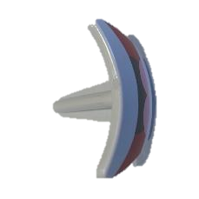
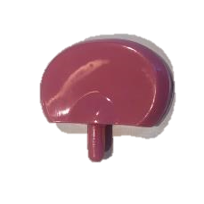
AAC Scavenger Hunt – Mr Potato Head
glasses
moustache
body
hat
eyes
tongue
nose
legs
arm
arm
mouth
ear

Slide 2
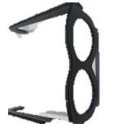
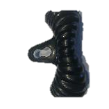
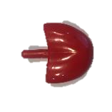
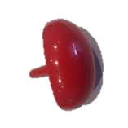
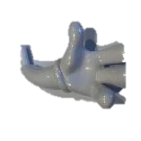
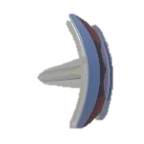
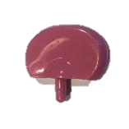
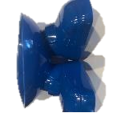
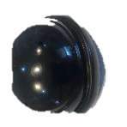
AAC Scavenger Hunt – Mr Potato Head
I
saw
glasses
moustache
body
eyes
tongue
nose
stop
like
arm
arm
mouth
don’t like
ear
legs
hat

Slide 3
AAC Scavenger Hunt – The Garden
I
saw
glasses
moustache
body
eyes
tongue
nose
stop
like
arm
arm
mouth
don’t like
ear
legs
hat

Slide 4
AAC Scavenger Hunt – The Garden
I
saw
glasses
moustache
body
mouth
you
found
eyes
tongue
nose
hat
stop
like
arm
arm
more
my turn
wait
don’t like
ear
legs
finished
your turn

Slide 5
AAC Scavenger Hunt – The Garden
I
saw
glasses
moustache
body
mouth
you
found
eyes
tongue
nose
hat
stop
like
arm
arm
more
my turn
wait
don’t like
ear
legs
finished
your turn

Slide 6
AAC Scavenger Hunt – The Garden
I
saw
glasses
moustache
body
mouth
you
found
eyes
tongue
nose
hat
stop
like
arm
arm
more
my turn
wait
don’t like
ear
legs
finished
your turn

Slide 7
AAC Scavenger Hunt – The Garden
I
saw
glasses
moustache
body
mouth
you
found
eyes
tongue
nose
hat
stop
like
arm
arm
more
my turn
wait
don’t like
ear
legs
finished
your turn

Slide 8
AAC Scavenger Hunt – The Garden
I
saw
glasses
moustache
body
mouth
you
found
eyes
tongue
nose
hat
stop
like
arm
arm
more
my turn
wait
don’t like
ear
legs
finished
your turn

Slide 9
AAC Scavenger Hunt – The Garden
I
saw
glasses
moustache
body
mouth
you
found
eyes
tongue
nose
hat
stop
like
arm
arm
more
my turn
wait
don’t like
ear
legs
finished
your turn

