Slide 1
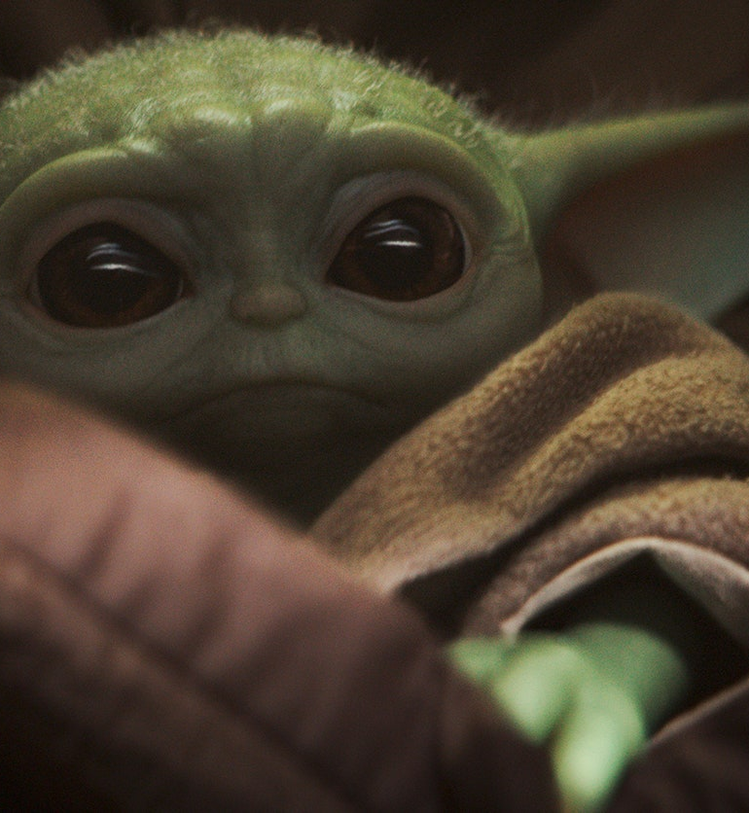
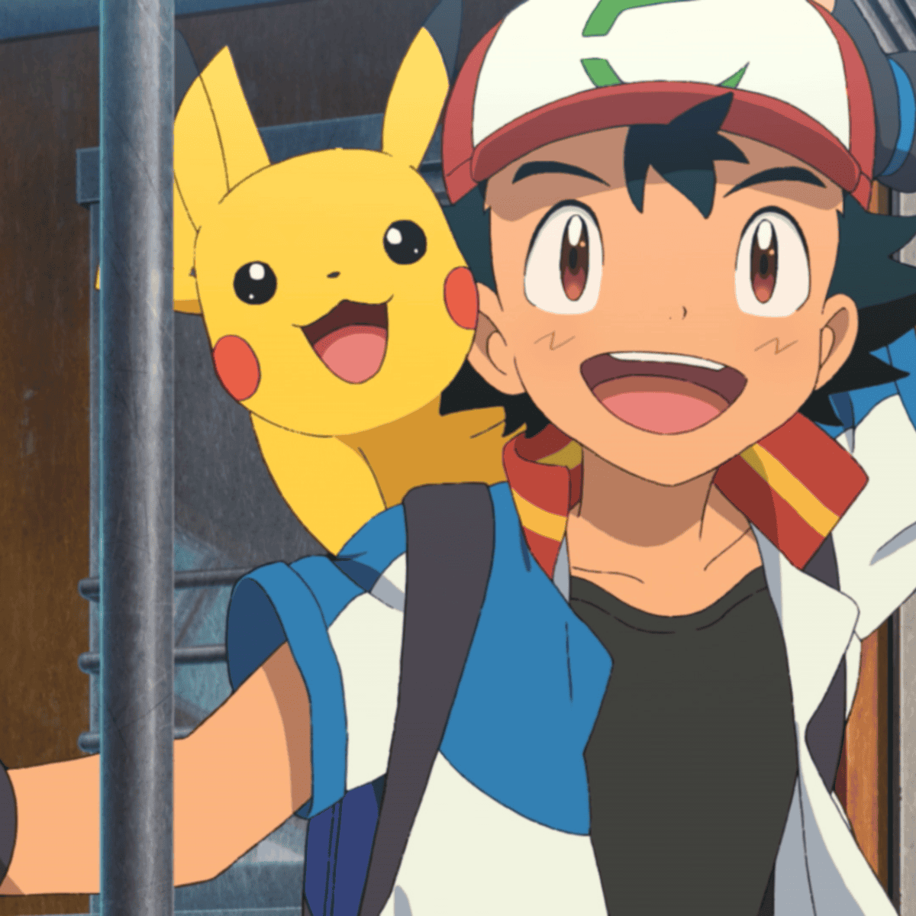
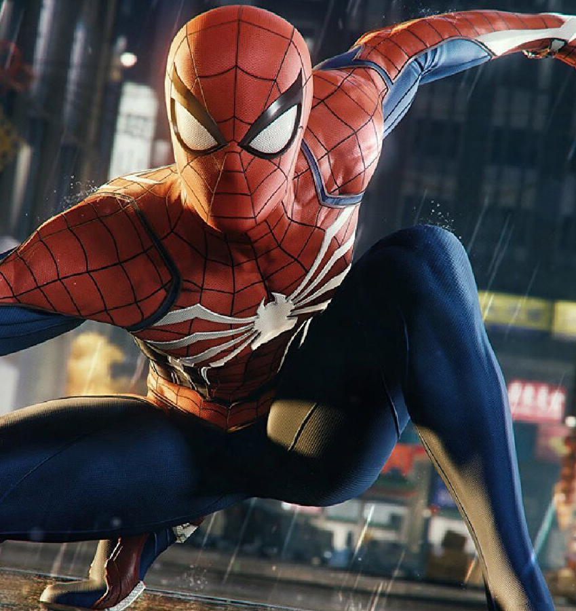
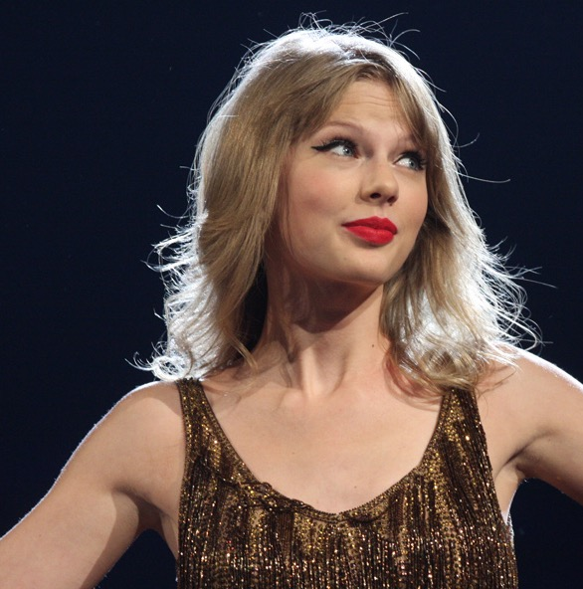
Ash and Pikachu work together if they get angry they can ask for time out
Spiderman helps people. He takes himself away when he is upset
Grogu doesn’t hit people.

